Slide 1
Ministry of Education Government of India
Unnat Bharat Abhiyan
PROCESS OF BECOMING A PARTCIPATING INSTITUTION
under
Regional Coordinating Institute
Malaviya National Institute of Technology Jaipur, Rajasthan

Slide 2
ABOUT UNNAT BHARAT ABHIYAN:
Unnat Bharat Abhiyan, a flagship national program of Ministry of Human Resource Development (MHRD) Government of India and IIT Delhi has been designated to function as lead and coordinating organization for UBA activities in the country. Unnat Bharat Abhiyan is inspired by the vision of transformational change in rural development processes by leveraging knowledge institutions to help build the architecture of an Inclusive India.
The Mission of Unnat Bharat Abhiyan is to enable participating higher educational institutions to work with the people of rural India in identifying development challenges and evolving appropriate solutions for accelerating sustainable growth. It also aims to create a virtuous cycle between society and an inclusive academic system by providing knowledge and practices for emerging professions and to upgrade the capabilities of both, the public and the private, sectors in responding to the development needs of rural India.

Slide 3
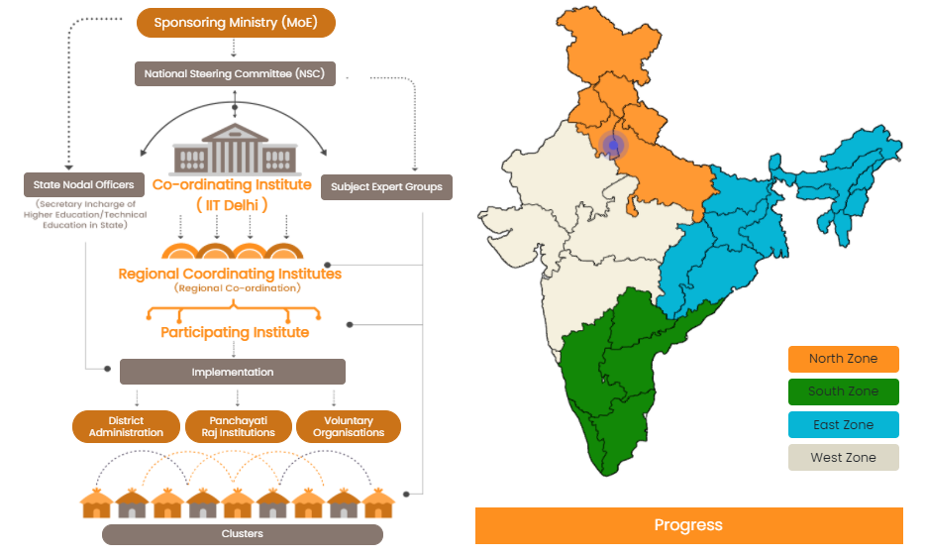
ORGANISATION STRUCTURE
https://unnatbharatabhiyan.gov.in/organisational_structure

Slide 4
Implementation Strategy (From PI perspective):
The Higher Educational Institutes will be selected as PI through a challenge mode, from both technical and non-technical streams, based on parameters such as - history of engagement with rural communities, adequate faculty, and commitment to the programme objectives.
The selected institutions will work with State Government, district authorities / PRIs / other institutions and non-governmental bodies, for arriving at suitable solutions for improving the social and economic wellbeing of the rural communities.
The selected institutions shall meet from their own resource’s expenses for the field visits, and any other expense that is not specifically funded under the scheme.
Institutions are expected to do field studies, study the implementation of Government schemes, and facilitate their better implementation so that they meet their objectives best.
PIs should engage interested faculties, students, NSS and other bodies of the institutes engaged in community activities.
Provision to have additional incentives to PIs, if they manage to receive grants from other sources.

Slide 5
Selection of the Participating Institutions (PIs) and Further Processes:
Higher Educational Institutions would be selected after receiving online responses to an open advertisement for participation in Unnat Bharat Abhiyan. The selection is based on challenge Mode. Selection of institutions would be followed by a training and orientation programme to expose the institutions to rural engagement mechanisms, rural technologies, and practices in present time. The orientation sessions will be organized jointly by RCI and the National Coordinating Institution.
The registration is online on the UBA website. The registration portal has been open for new institutions though out year. The results of selected institutions will be quarterly announced on UBA website.
After registration and selection of the institutes under the UBA, a token amount of Rs.10,000/- per village would be released under the UBA program. The funds are mainly meant for assistance for awareness, Gram Panchayat Development Plan (GPDP) study, need assessment, and contingency expenditure.

Slide 6
Selection of the Participating Institutions (PIs) and Further Processes:
A login credentials will be provided to each selected participating institution for UBA Reporting Portal to upload survey data on UBA website. This ‘REPORTING PORTAL’ can be used by all participating institutes to feed data obtained from Village and Household surveys, prepare plans and report their complete work progress.
The selected institutions will work for providing suitable solutions which can improve the social and economic well-being of the rural communities.
The solutions selected/ customized should be sustainable, innovative, implementable and scalable. Where new technological solution is to be developed or existing technological solution is to be customized, as per the local requirements, additional grant would be available under the scheme, as recommended by the Subject Expert Groups.
Identification of solutions by the Institutions would take place after a qualitative engagement with the rural people, local bodies, district authorities and obtaining a clear insight into the problems and requirements of the adopted villages.

Slide 7
Selection of the Participating Institutions (PIs) and Further Processes:
The solutions proposed should be uploaded on the UBA portal giving a clear statement of the problem, proposed solution, with proof of requirement & willingness to fund the solution by the District Authorities/ Central and State Government/ Corporates/ Philanthropies, cost of the solutions etc. which would be verified by the Subject Expert Group (SEG).
After evaluation of the proposed solutions, assistance would be recommended by SEG up to Rs.1 lakh per technology for selection of technical solutions and up toRs.50,000/- for customization of any existing solution in a village. This amount is towards meeting the gap in fund availability.
All selected solutions are to be executed in the village with the assistance of the Gram Panchayat and outcomes to be recorded by the institutions.
A web based monitoring system is in place for all progress upload on the Portal by the institutions along with photographs.
The proposed intervention in any village should be discussed prioritized, and approved by Gram shabha.

Slide 8
Kindly find all pertinent information below for your reference:
About the program -- UNNAT BHARAT ABHIYAN : https://unnatbharatabhiyan.gov.in:8443/introduction
About PI : https://unnatbharatabhiyan.gov.in:8443/participating_institute
About the process to be a part of UBA as PI –
For details and joining the UBA program,: https://unnatbharatabhiyan.gov.in:8443/faq3
Please use the registration URL: http://115.124.102.238:8081/ to join UBA
Kindly go through the following links for completing your registration.
https://www.youtube.com/watch?v=x56DQJkgelI&feature=youtu.be
https://www.youtube.com/watch?v=g7ILWONQWjs&feature=youtu.be

Slide 9
IN CASE OF ANY QUERY
KINDLY CONTACT US WITH OUR EMAIL ID : rci-uba@mnit.ac.in OR WITH THE HELP OF THE GOOGLE FORM IN THE CONTACT US SECTION
THANK YOU

